Slide 1
Performance analysis of multi-threading in In-Memory Data-Stores
Grégory Ludovic Maitre
Patrick Daniel Oliveira Andrade
29st May 2015

Slide 2
Outline
What is a Key-Value Store
Goals
Load and metric
Factors
Method
Experiments
Numerical Analysis
Conclusion

Slide 3
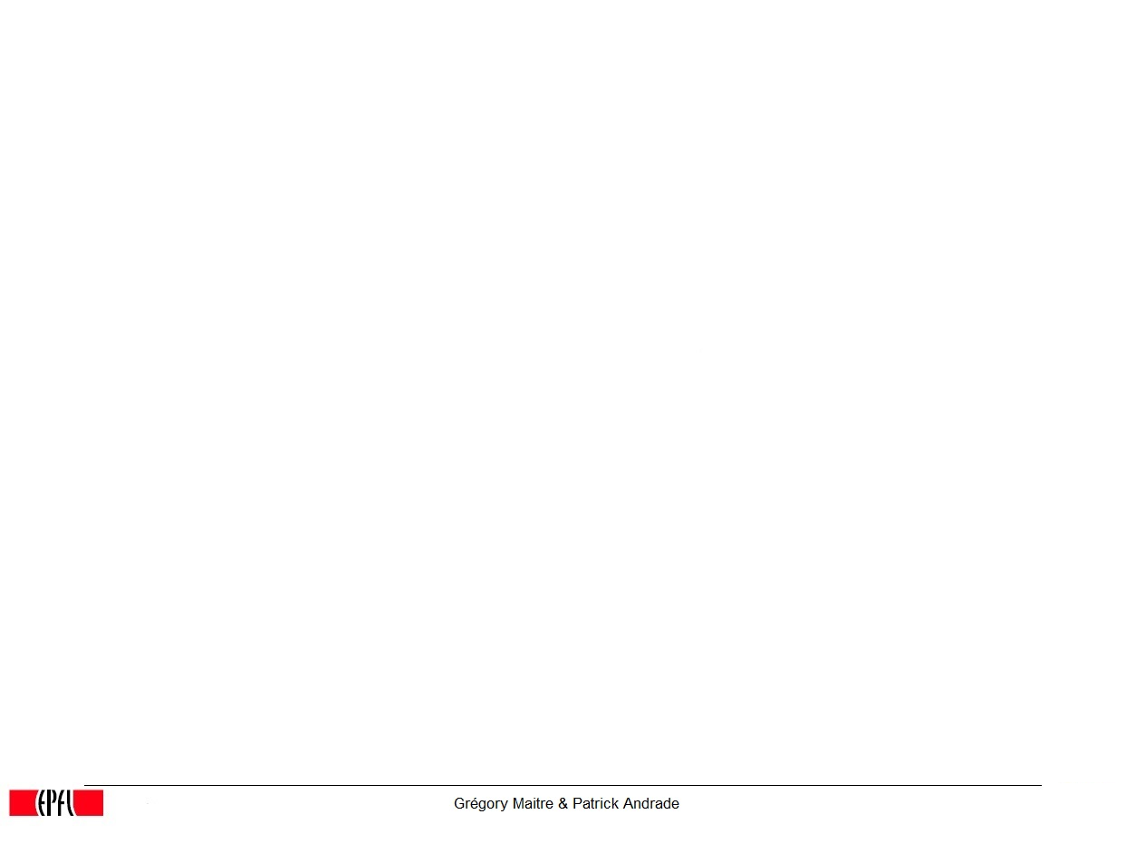

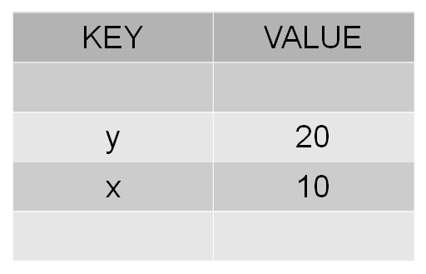
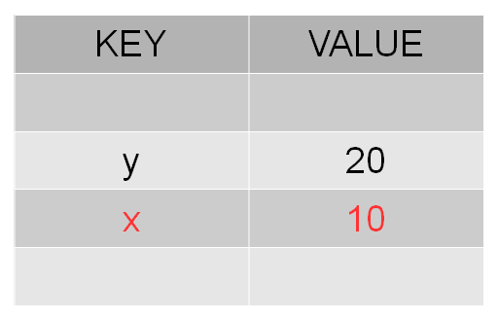
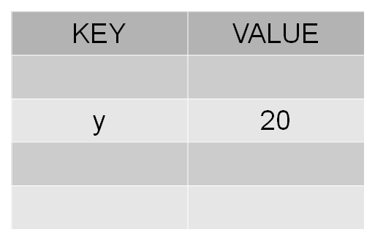
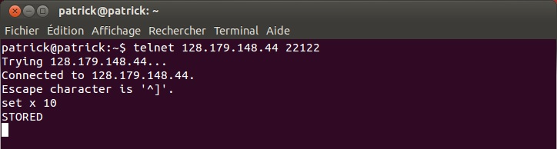
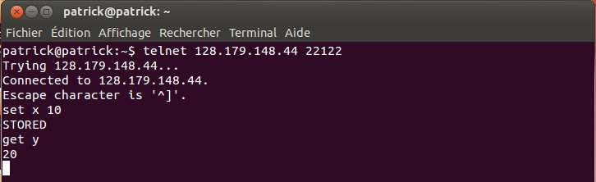
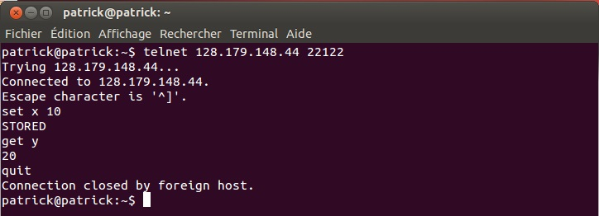
Quick example of a Key-Value store
Notes:
3

Slide 4

Key-Value Store
Single Threaded vs Multi Threaded
Blocking version vs Pipelined version
Standard Java IO vs Java NIO
Different Lock Mechanisms
Global Lock
Key Lock
Maps Lock
No Lock
Example: NIOMultiGlobalLock

Slide 5
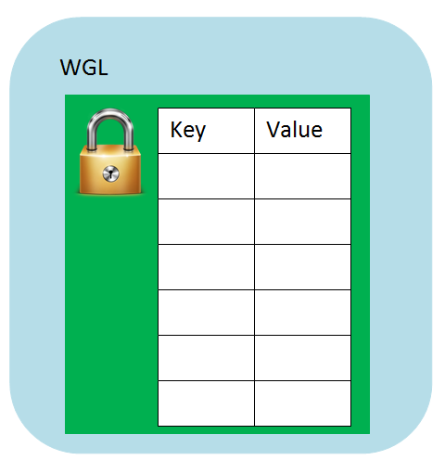
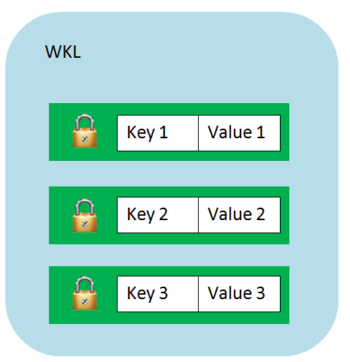
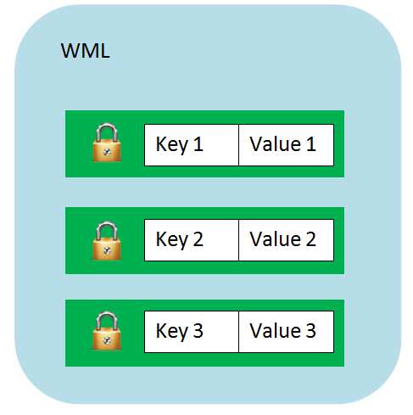

Lock Mechanism
LocksHelper

Slide 6
Goals
Evaluate the performance of all the architectures of In-Memory Data-Stores that we built
Compare the performances between the different architectures
Give suitable architecture depending on average clients served
Performance analysis will be, in this case, analysis of the average waiting time of a client for an answer after performing a request to the data-store

Slide 7
Load and metric
Load generated by benchmarks that send randomly requests to get/set data with some random key in a range of one hundred predefined keys and with some random value in a range of one hundred predefined values.
Metric is the average response time of any request to the different data-stores

Slide 8
Factors
Network (EPFL WiFi/private Ethernet)
System load (one server machine and one client machine)

Slide 9
Method
As previously mentioned, running different benchmarks to evaluate the average waiting time for an answer to come back from the data-store.

Slide 10
Experiments
From 1 to 500 parallel clients (step of 1) each sending 100 randomized requests over EPFL WiFi and Ethernet private network.
From 1 to 500 parallel clients (step of 20) each sending 100 randomized requests over Ethernet private network. Each experiment is done 20 times.
Set the number of clients (10, 25, 50 and 300), each sending 100 requests over Ethernet. Each experiment is done 300 times.

Slide 11
Numerical Analysis:
Goals recall
Evaluate the performance of all the architectures of In-Memory Data-Stores that we built
Compare the performances between the different architectures
Give suitable architecture depending on average clients served
Performance analysis will be, in this case, analysis of the average waiting time of a client for an answer after performing a request to the data-store

Slide 12
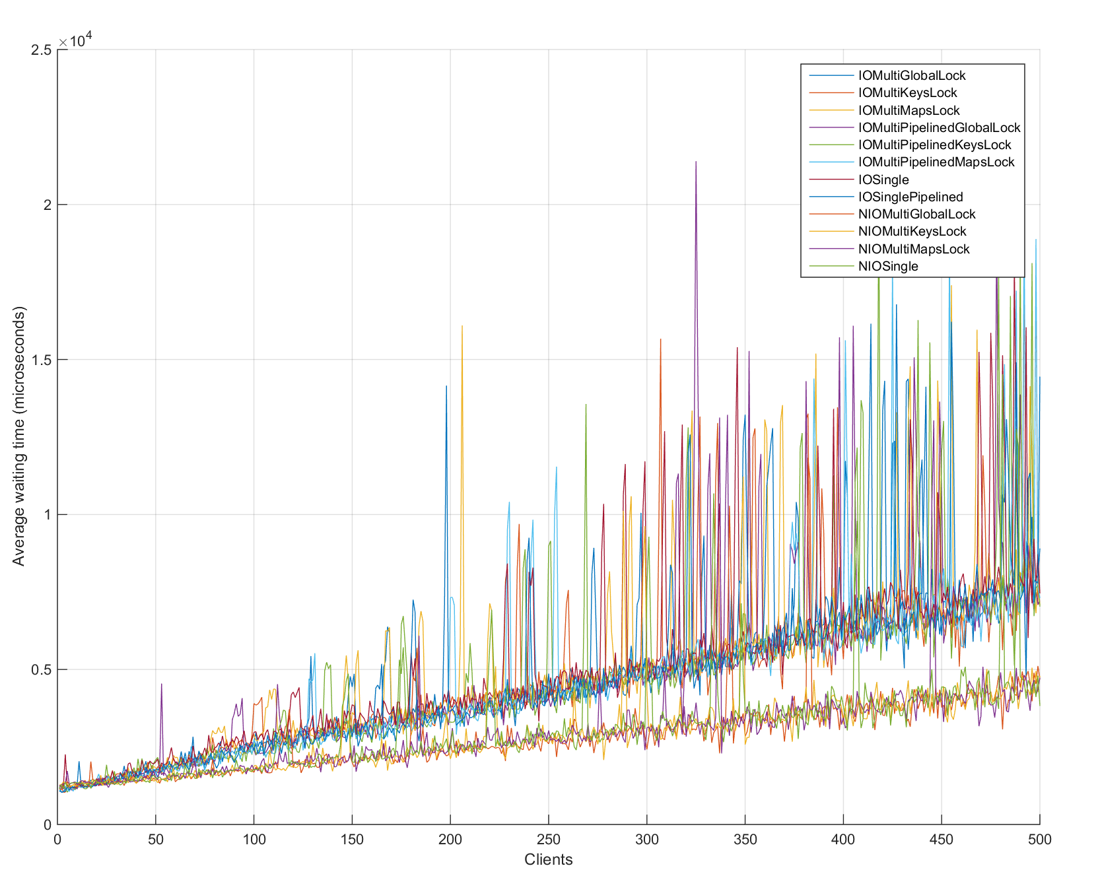
1 to 500 clients over EPFL WiFi
NIO architectures tend to be better than classical IO of java.
However, to much variability to conclude anything.

Slide 13
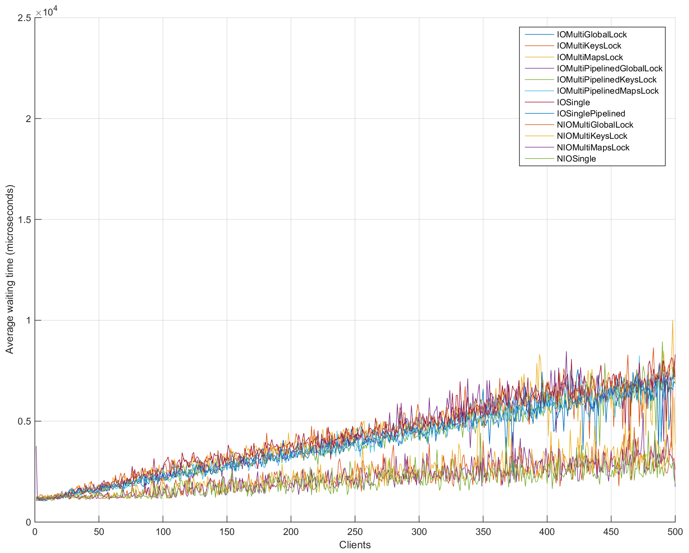
1 to 500 clients over private Ethernet network
NIO architectures tend to be better than classical IO of java.
Less variability than on Wifi.
Overall performances seem better.
Still difficult to evaluate performances between java IO architectures themselves. Same for java NIO.

Slide 14
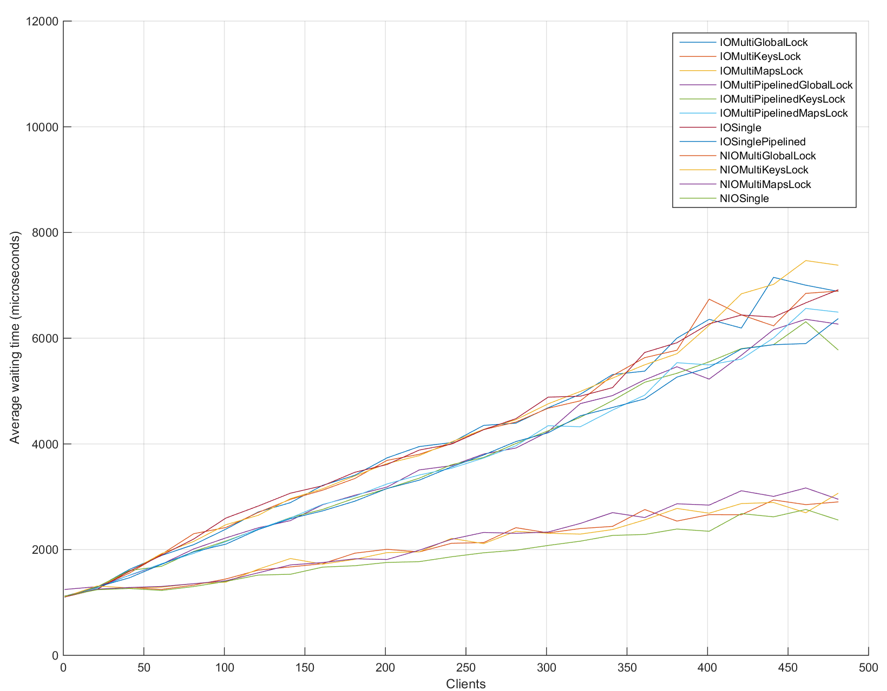
1 to 500 clients (step 20) : mean value
NIO architectures better than classical IO of java after 25 parallel clients.
Can distinguish better architectures among IO and NIO ones.

Slide 15
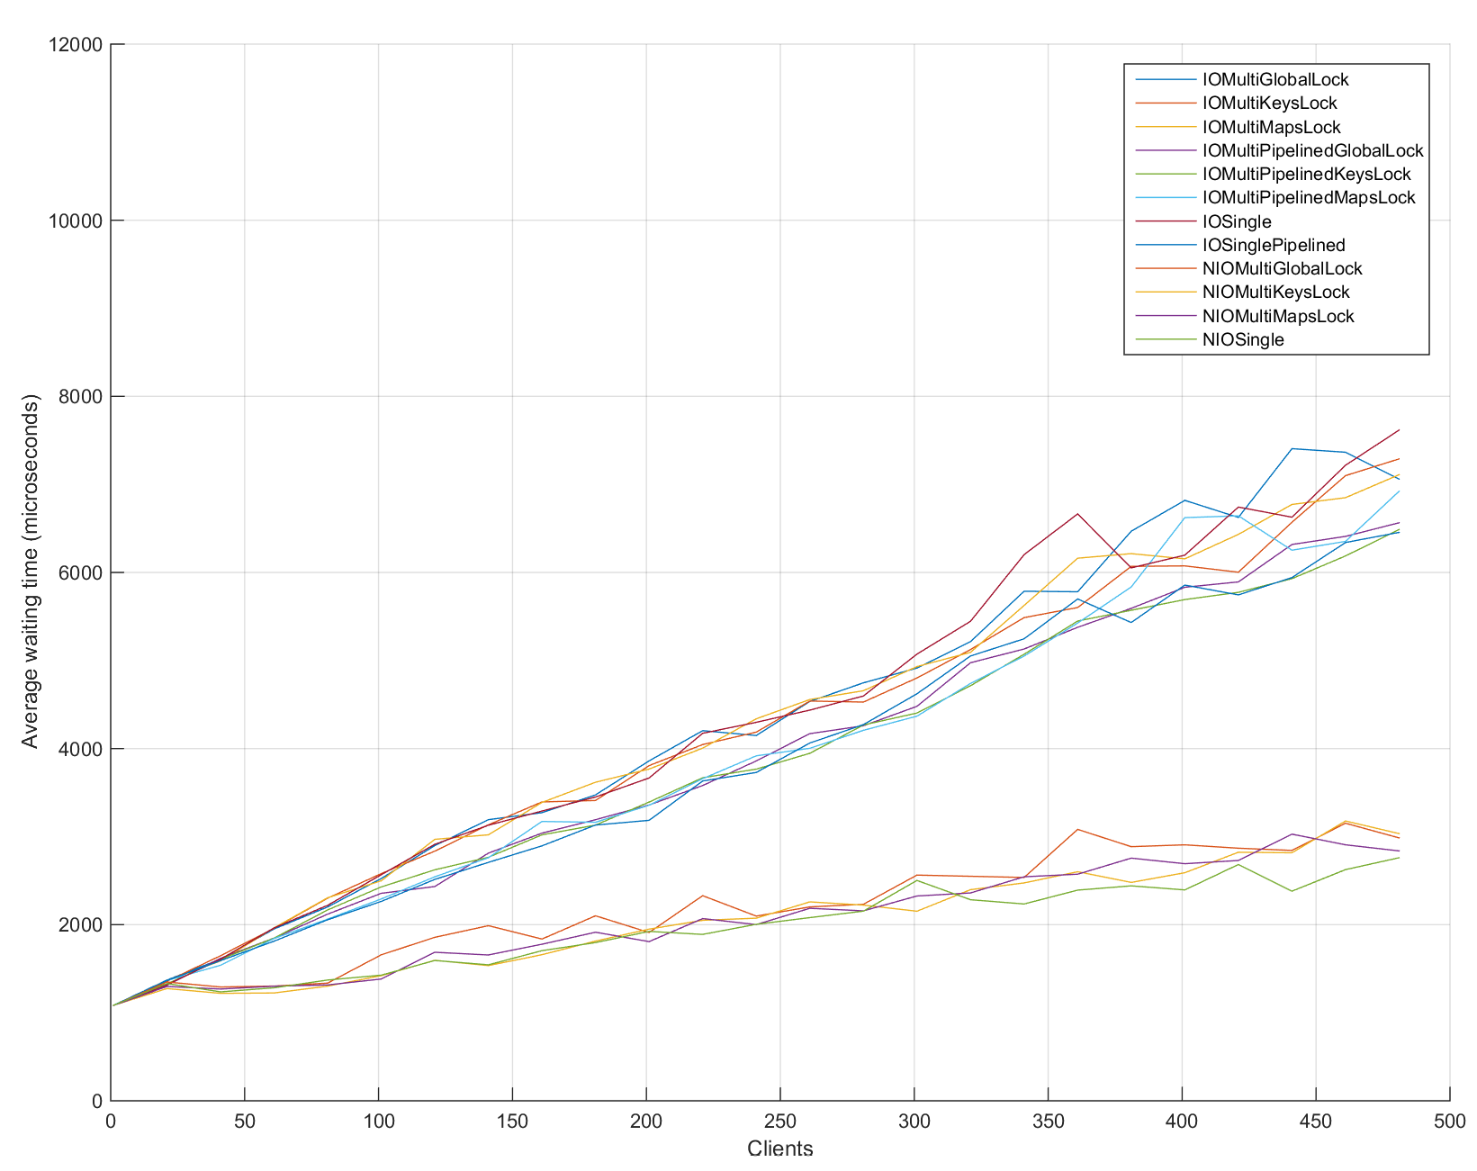
1 to 500 clients (step 20) : median value
NIO architectures better than classical IO of java after 25 parallel clients.
Can distinguish better architectures among IO and NIO ones.
It is the median value so it is more robust to outliers if any.

Slide 16
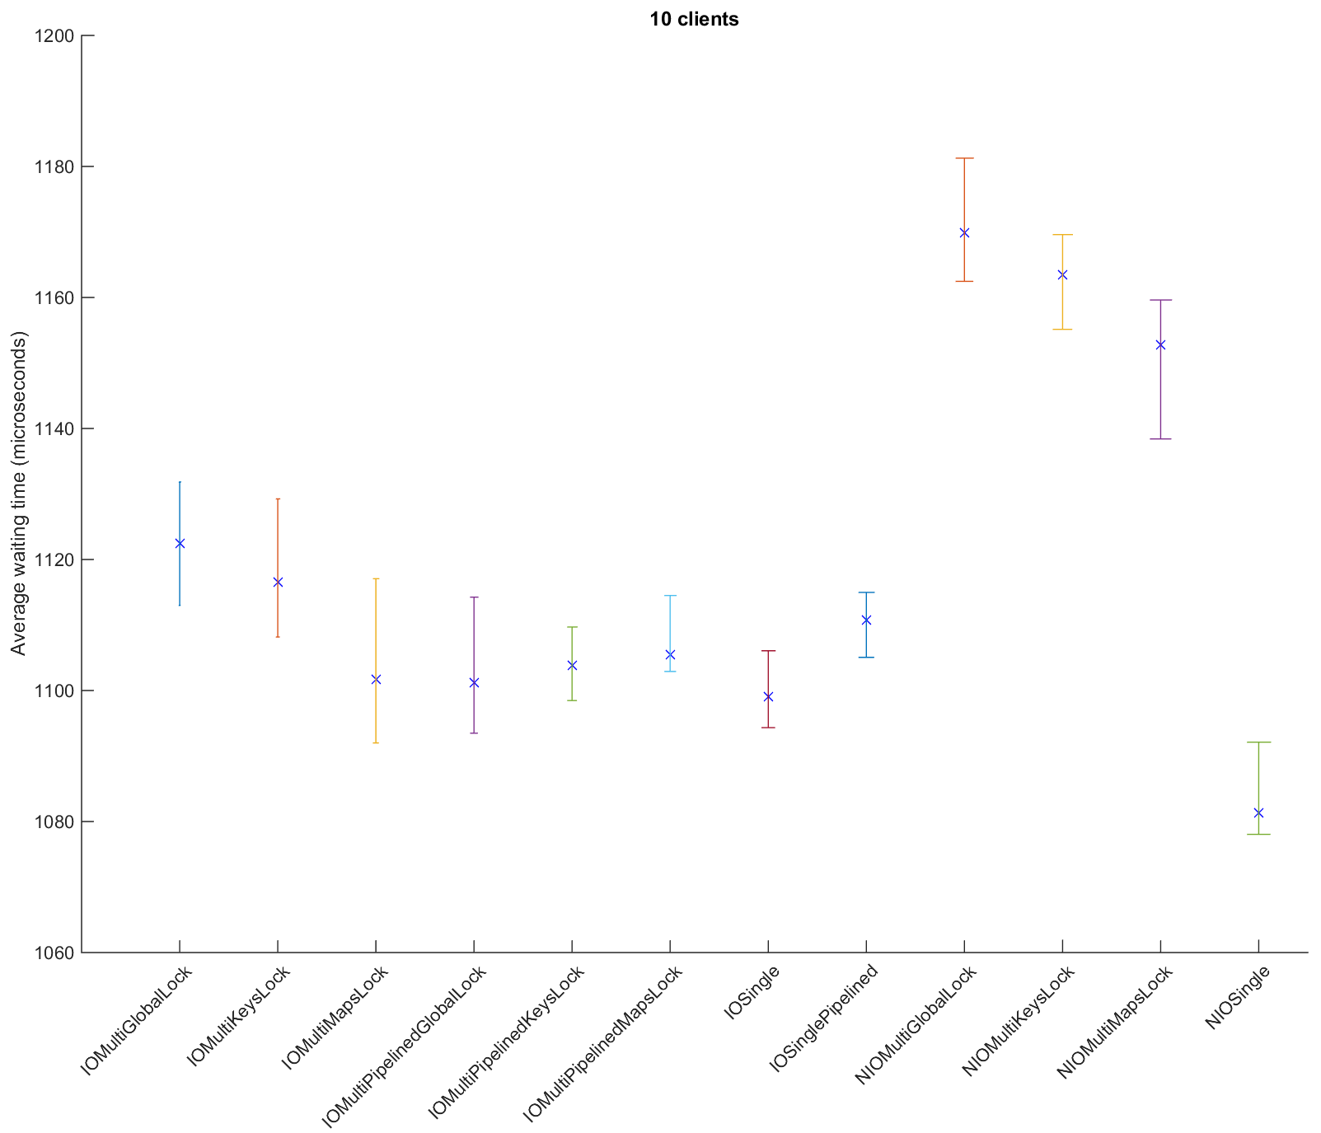
Confidence Interval for the median : 10 clients
IO architectures very competitive with the NIO ones.
NIOSingle architecture is the best in front of all IO architectures.
IOSingle is one of the bests architectures.

Slide 17
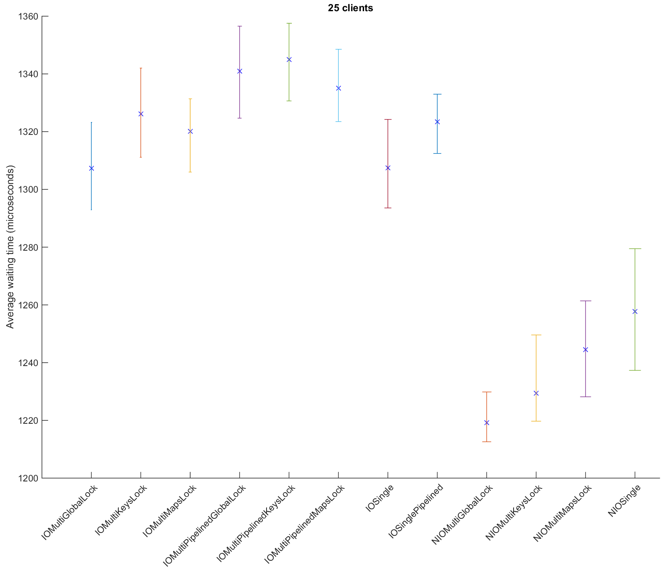
CI for the median : 25 clients
NIO architectures already “better” than the IO ones.
Better is only in a maximum of 1.15 times

Slide 18
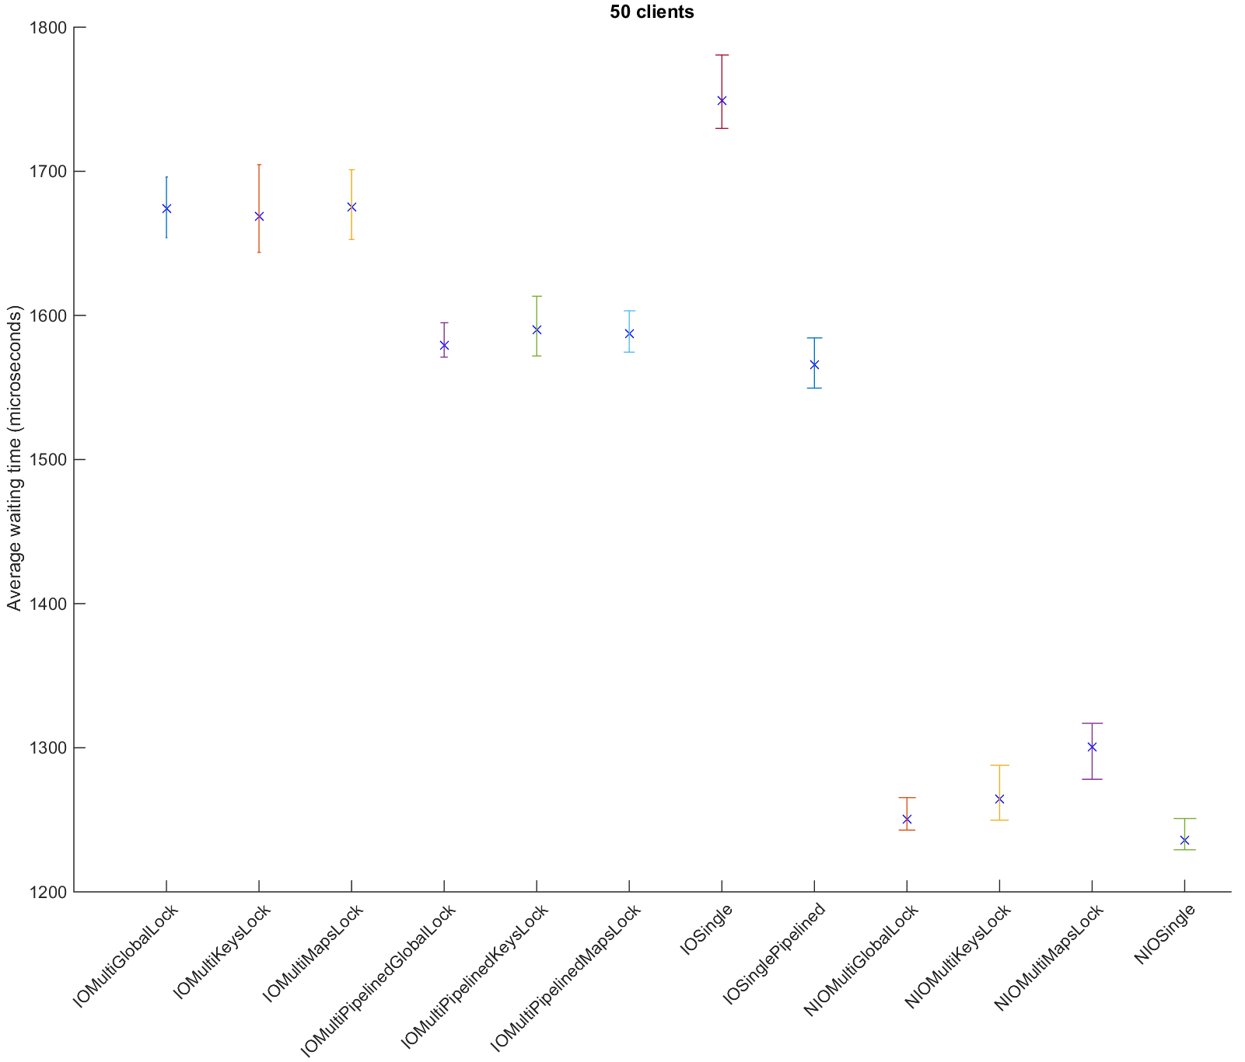
CI for the median : 50 clients
NIO architectures are better than the IO ones.
Better is at around 1.30 times.
IO Single becomes the worst architecture.
IOPipelined architectures tend to be better among the IO ones.

Slide 19
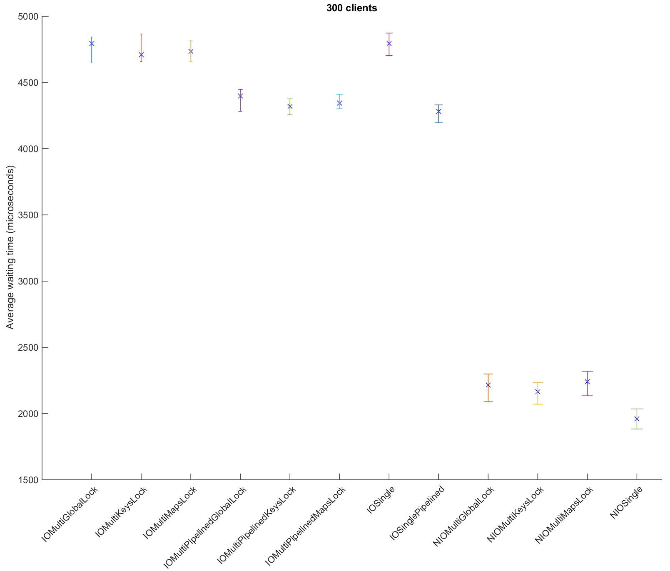
CI for the median : 300 clients
NIO architectures are clearly better than the IO ones.
Better is at more than 2 times.
NIOSingle still the best architecture.
IOPipelined architectures are still the best among the IO ones.

Slide 20

Conclusion
Until 500 clients, the growth is linear for any architecture.
Java NIO architectures become better than IO ones between 10 and 25 parallel clients.
Suitable architectures :
Clients <= 10 : NIOSingle (or IOSingle)
10 < Clients <= 50 : NIOMultiGlobalLock (or another NIO architecture)
Clients > 50 : NIOSingle (or another NIO architecture)
IOPipelined pay off after 25 parallel clients. Before, IOSingle is the best for the IO ones. After that, avoid use of IOSingle.

Slide 21

Thank you for your attention

